Slide 1
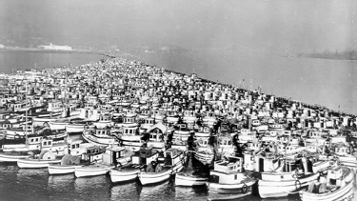

Slide 2
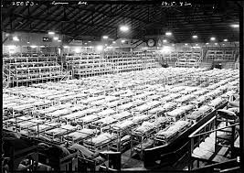
Hastings Park

Slide 3
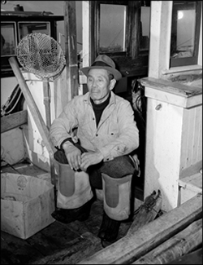

Slide 4
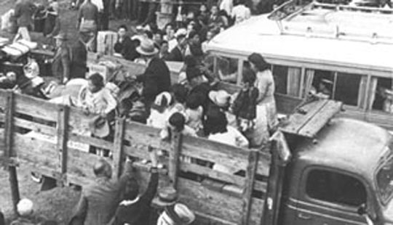

Slide 5
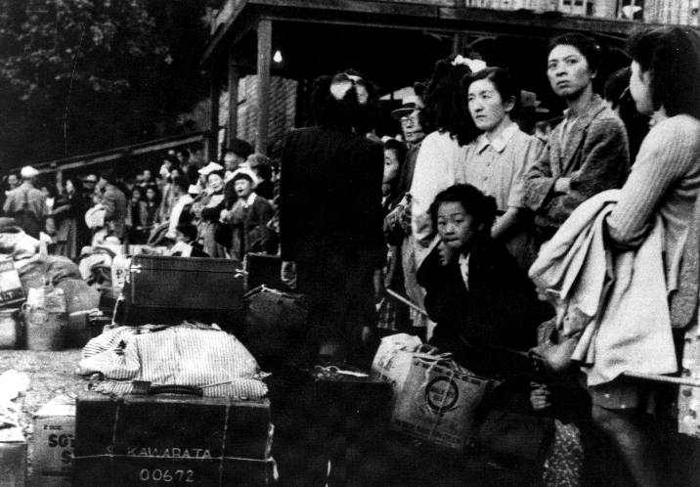

Slide 6
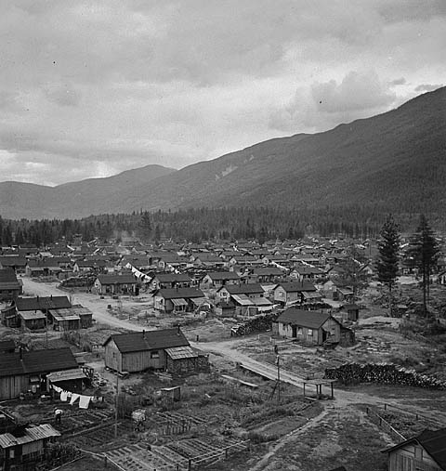
New Denver Internment Camp

Slide 7
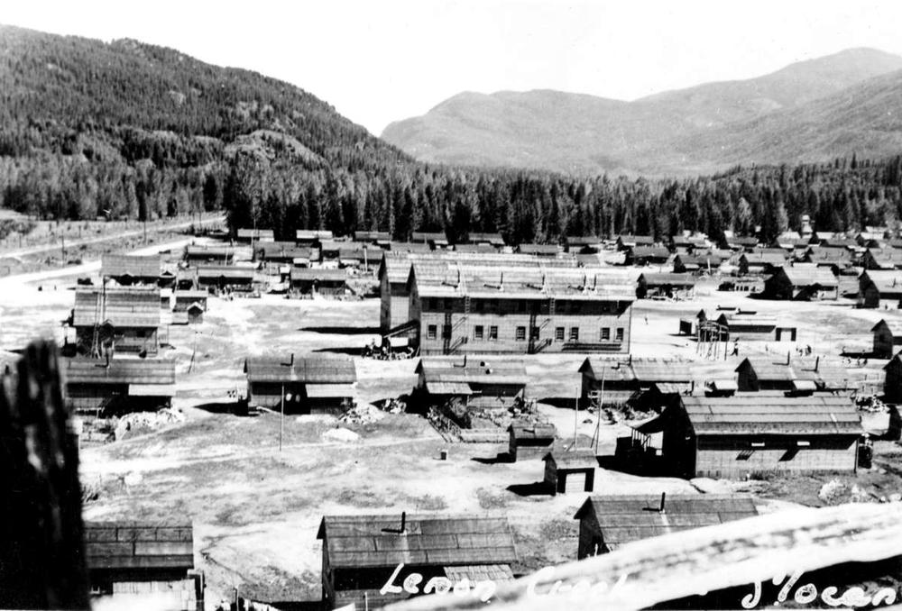

Slide 8
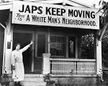

Slide 9
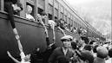

Slide 10
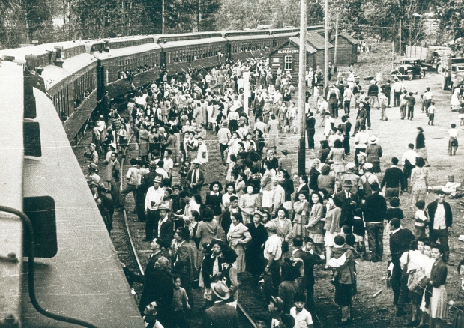

Slide 11
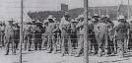

Slide 12
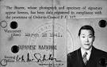
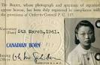
Cf. p. 24

Slide 13
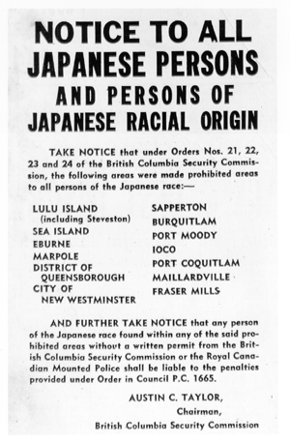

Slide 14
Order in Council of Ottawa - 26-2-1942
Order In Council Notice:
NOTICE
TO ALL PERSONS OF JAPANESE RACIAL ORIGIN
Having reference to the Protected Area of British Columbia as described in an Extra of the Canada Gazette, No. 174 dated Ottawa, Monday, February 2, 1942:
1. EVERY PERSON OF THE JAPANESE RACE, WHILE WITHIN THE PROTECTED AREA AFORESAID, SHALL HEREAFTER BE AT HIS USUAL PLACE OF RESIDENCE EACH DAY BEFORE SUNSET AND SHALL REMAIN THEREIN UNTIL SUNRISE ON THE FOLLOWING DAY, AND NO SUCH PERSON SHALL GO OUT OF HIS USUAL PLACE OF RESIDENCE AFORESAID UPON THE STREETS OR OTHERWISE DURING THE HOURS BETWEEN SUNSET AND SUNRISE; 2. NO PERSON OF THE JAPANESE RACE SHALL HAVE IN IS POSSESSION OR USE IN SUCH PROTECTED AREA ANY MOTOR VEHICLE, CAMERA, RADIO TRANSMITTER, RADIO RECEIVING SET, FIREARM, AMMUNITION OR EXPLOSIVE; 3. IT SHALL BE THE DUTY OF EVERY PERSON OF THE JAPANESE RACE HAVING IN HIS POSSESSION OR UPON HIS PREMISES ANY ARTICLE MENTIONED IN THE NEXT PRECEDING PARAGRAPH, FORTHWITH TO CAUSE SUCH ARTICLE TO BE DELIVERED UP TO ANY JUSTICE OF THE PEACE RESIDING IN OR NEAR THE LOCALITY WHERE ANY SUCH ARTICLE IS HAD IN POSSESSION, OR TO AN OFFICER OR CONSTABLE OF THE POLICE FORCE OF THE PROVINCE OR CITY IN OR NEAR SUCH LOCALITY OR TO AN OFFICER OR CONSTABLE OF THE ROYAL CANADIAN MOUNTED POLICE. 4. ANY JUSTICE OF THE PEACE OR OFFICER OR CONSTABLE RECEIVING ANY ARTICLE MENTIONED IN PARAGRAPH 2 OF THIS ORDER SHALL GIVE TO THE PERSON DELIVERING THE SAME A RECEIPT THEREFOR AND SHALL REPORT THE FACT TO THE COMMISSIONER OF THE ROYAL CANADIAN MOUNTED POLICE, AND SHALL RETAIN OR OTHERWISE DISPOSE OF ANY SUCH ARTICLE AS DIRECTED BY THE SAID COMMISSION.

Slide 15
5. ANY PEACE OFFICER OR ANY OFFICER OR CONSTABLE OF THE ROYAL CANADIAN MOUNTED POLICE HAVING POWER TO ACT AS SUCH PEACE OFFICER OR OFFICER OR CONSTABLE IN THE SAID PROTECTED AREA, IS AUTHORIZED TO SEARCH WITHOUT WARRANT THE PREMISES OR ANY PLACE OCCUPIED OR BELIEVED TO BE OCCUPIED BY ANY PERSON OF THE JAPANESE RACE REASONABLY SUSPECTED OF HAVING IN HIS POSSESSION OR UPON HIS PREMISES ANY ARTICLE MENTIONED IN PARAGRAPH 2 OF THIS ORDER, AND TO SEIZE ANY SUCH ARTICLE FOUND ON SUCH PREMISES; 6. EVERY PERSON OF THE JAPANESE RACE SHALL LEAVE THE PROTECTED AREA AFORESAID FORTHWITH; 7. NO PERSON OF THE JAPANESE RACE SHALL LEAVE THE PROTECTED AREA EXCEPT UNDER PERMIT ISSUED BY THE ROYAL CANADIAN MOUNTED POLICE; 8. IN THIS ORDER, "PERSONS OF THE JAPANESE RACE" MEANS, AS WELL AS ANY PERSON WHOLLY OF THE JAPANESE RACE, A PERSON NOT WHOLLY OF THE JAPANESE RACE IF HIS FATHER OR MOTHER IS OF THE JAPANESE RACE AND IF THE COMMISSIONER OF THE ROYAL CANADIAN MOUNTED POLICE BY NOTICE IN WRITING HAS REQUIRED OR REQUIRES HIM TO REGISTER PURSUANT TO ORDER-IN-COUNCIL P.C. 9760 OF DECEMBER 16th, 1941.
DATED AT OTTAWA THIS 26th DAY OF FEBRUARY, 1942.
Louis S. St. Laurent Minister of Justice

Slide 16
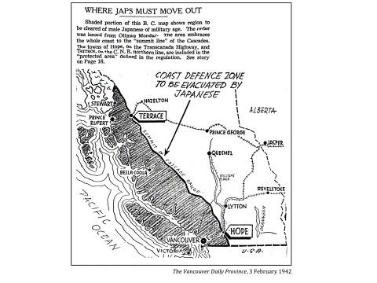

Slide 17
Prior to World War II, 22,096 Japanese Canadians lived in British Columbia; three quarters of them were naturalized or native born Canadians. During the war, 21,460 were forcibly removed from their homes; families were broken up and sent to internment camps. After the war, 3,964 were deported to Japan; one third of them were Canadian citizens.
In 1950, the Bird Commission’s report resulted in an offer of $ 1.2 million compensation to Japanese Canadians. A 1987 Price Waterhouse study estimated real property loss at $ 50 million, total economic loss at $ 443 million.
The Royal Canadian Mounted Police and Canadian military advisers did not consider the Japanese Canadian community on the West Coast as a threat to domestic security.
In the U.S., families were interned together. In Canada, initially, families were separated.
In the U.S., constitutional protections forbade the sale of property. In Canada, the government seized and sold land and personal property. In the U.S., housing and food were provided. In Canada, internees paid for food, clothes and basic improvements in housing from savings and proceeds of property sales.
In the U.S., the government moved quickly in 1944-45 to rescind exclusion orders and to allow the return of citizens to the West Coast. In Canada, Japanese Canadians were forced to decide on deportation to Japan or relocation to parts east of the Rockies.
The 10 internment camps, 3 road camps, 2 prisoner of war camps, and 5 self-supporting camps were scattered throughout Canada. During the war years, Japanese Canadians were regarded as possible threats to Canada’s domestic security. Their actions were monitored; their rights suspended. Yet no hearings or trials were ever held and no charges of treason were ever laid
Cf. p. 35

Slide 18
Escott Reid, reflecting on a conference held on Jan 8, 1942 in which the RCMP’s opinion that the Japanese Canadian were “loyal” was overwhelmingly rejected by the BC delegation supported by some federal representatives, wrote:
“They spoke of the Japanese Canadians in the way that the Nazis would have spoken about Jewish Germans. When they spoke, I felt in that committee room, the physical presence of evil.”

Slide 19
Angus MacInnes, Member of Parliament from British Columbia, 1943:
“I see no reason why we should deal with the population of Japanese origin among us any differently from the way in which we deal with those of German and Italian extraction. If we deal with them differently – and we have done so – we do it an account of racial prejudice.”

Slide 20
Thomas Reid, Member of Parliament for New Westminster, January 15, 1942:
“Take them back to Japan. They do not belong here, and here, and there is only one solution to the problem. They cannot be assimilated as Canadians for no matter how long the Japanese remain in Canada they will always be Japanese.”

Slide 21
Prime Minister Mackenzie King, House of Commons, 1944:
“The sound policy and the best policy for the Japanese Canadians themselves is to distribute widely as possible throughout the country where they will not create feelings of racial hostility.”

Slide 22
Re Race versus Citizenship:
In May 1945 a Nisei woman wrote to her brother in Ontario:
Through no fault of our own we happened to be born of Japanese parents, however, as you know, all were educated in Canadian system of governing Democracy. Right of free speech, etc. etc., no matter what race colour, or creed. Well, these ignorant “so-and-so’s” think they’re the only ones in this country that’s entitled to live.... With all the raw deals and racial hatred towards us I’m still proud to say that I’m a Canadian of Japanese ancestry. I was created to be one and will live up to one.
PAMELA SUGIMAN, “Passing Time, Moving Memories: Interpreting Wartime Narratives of Japanese Canadian Women.” Social History: Vol 37, No 73, 2004
Cf. pp. 41-43; 93: Ch . 14 entry for Feb. 15, 1942.

Slide 23
Nisei woman in Toronto to her girlfriend in Alberta, August 1944:
They call us “Japs”and think of us in the same light that they think of the native Japanese. I think there are very few people that really consider us as “fellow Canadians” ... even among our occidental friends. I suppose it all boils down to the fact that we have black hair and oriental features and we look so different from the other races that we can never become quite as Canadianized as the rest. . .
Same source

Slide 24
To her husband in Angler, an Issei woman in Lemon Creek wrote
(July 1944):
My worries are greater than yours. Every day with the temperature at hundred and twenty degrees I have to go to negotiate and every time I go to the Welfare I have to fight. Not receiving sufficient for our daily necessities I have had to use what I had but had saved.... And who has made us suffer in this way taking away my husband who is guiltless and interning him. And is it not a wilful thing to do by taking away the subsistence and then telling me to go out to work. [From wife in Lemon Creek to her husband in Angler,, written in Japanese]
Same source
Cf. 95; Ch 14 entry for March 12.

Slide 25
From woman in Greenwood to her husband in Angler, July 11, 1944:
I took all the notes of what I had earned by working in the fields, of what I spent and bills of things I had bought ... I had twenty-seven dollars and eighty-one cents left.... With that [money received from the B.C. Security Commission] and the twenty-seven dollars and eighty-one cents I was told to maintain myself for three months. This was really too exasperating. I think one cannot be blamed for grumbling after being told a ridiculous thing like that and also after working so hard in the fields. They seem to think we can produce work for ourselves.... It really makes me miserable to think that we are getting no where except in years.
Same source.

Slide 26
Muriel Kitagawa to her brother, Wes. March 4, 1942:
We are Israelites on the move. The public is getting bloodthirsty and will have our blood Nazi-fashion. Okay we move. But where? Signs up on all highways...JAPS KEEP OUT. Curfew. "My father is dying. May I have permission to go to his bedside?" "NO!" Like moles we burrow within after dark, and only dare to peek out of the window or else be thrown into the hoosegow with long term sentences and hard labour. Confiscation of radios, cameras, cars and trucks. Shut down of all business. No one will buy. No agency yet set up to evaluate. When you get a notice to report to RCMP for orders to move, you report or be interned. "Who will guard my wife and daughters?" Strong arm reply. Lord, if this was Germany you can expect such things as the normal way, but this is Canada, a Democracy! And the Nisei, repudiated by the only land they know, no redress anywhere. Sure we can move somewhere on our own, but a job? Who will feed the family? Will they hire a Jap? Where can we go that will allow us to come? The only place to go is the Camp the Government will provide when it gets around to it. Ah, but we are bewildered and bitter and uncertain...
Cf. 119-120

Slide 27
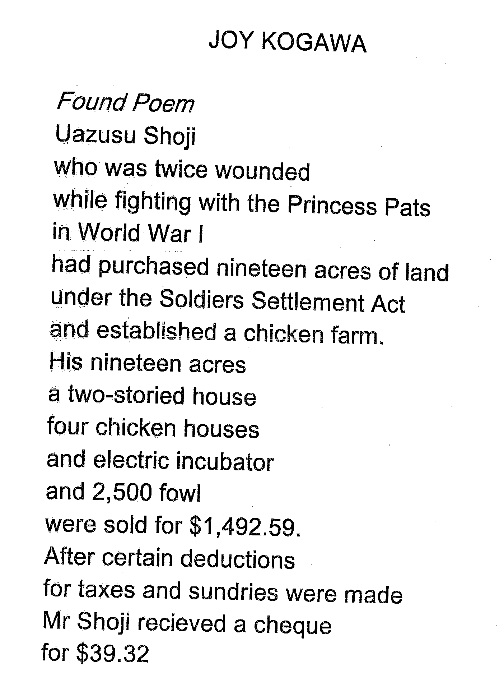
Cf. pp. 38-40

Slide 28
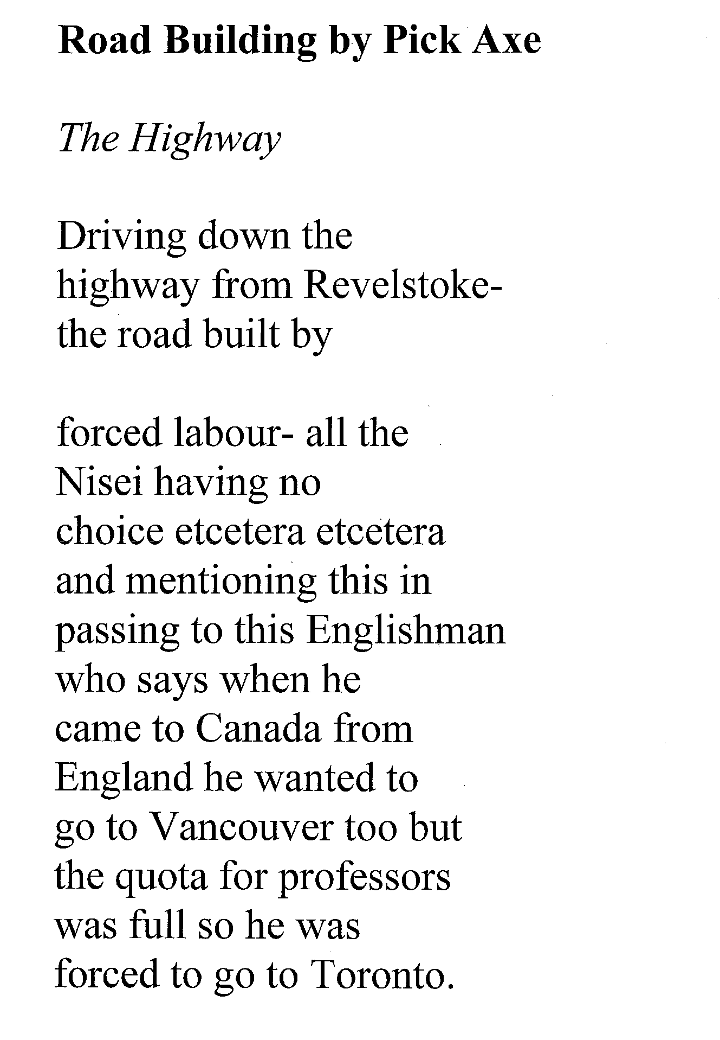

Slide 29
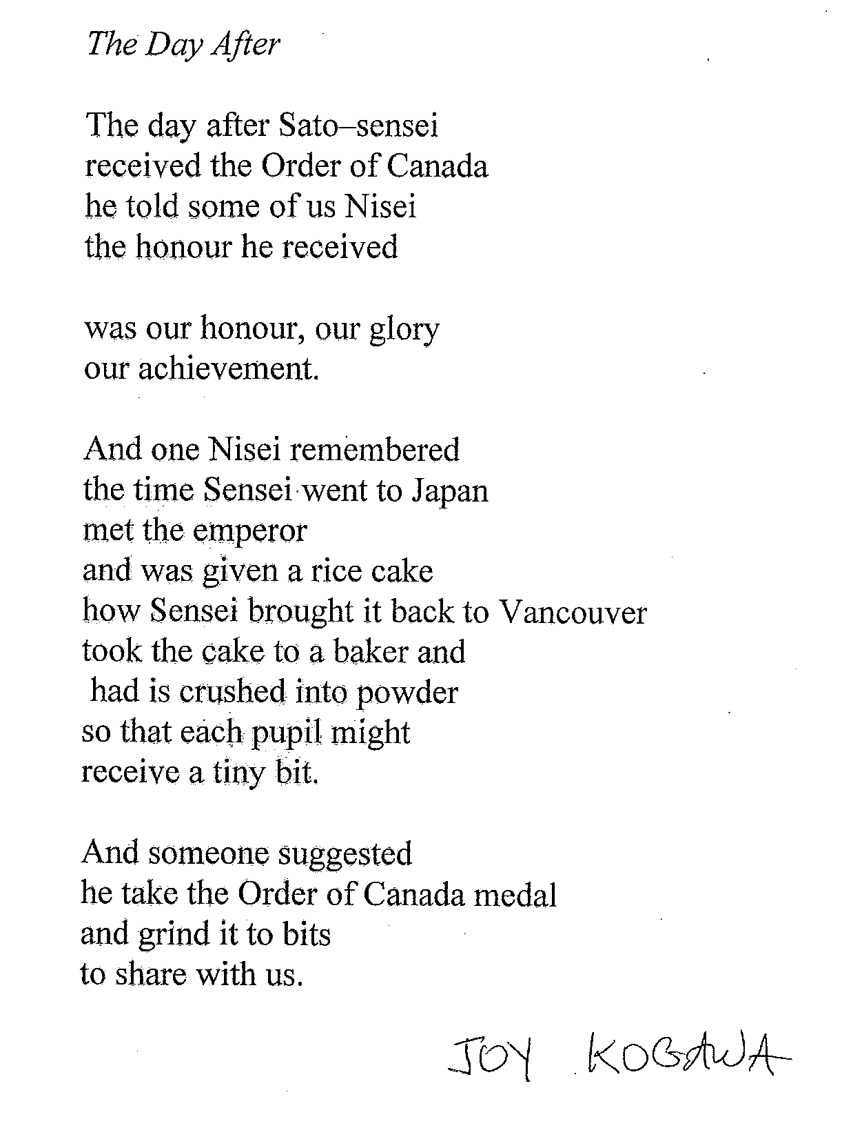

Slide 30
What Do I Remember of the Evacuation by Joy Kogawa
What do I remember of the evacuation? I remember my father telling Tim and me About the mountains and the train And the excitement of going on a trip. What do I remember of the evacuation? I remember my mother wrapping A blanket around me and my Pretending to fall asleep so she would be happy Though I was so excited I couldn’t sleep. (I hear there were people herded Into the Hastings Park like cattle Families where made to move in two hours Abandoning everything, leaving pets And possessions at gun point. I hear families were broken up Men were forced to work. I heard It whispered late at night That there was suffering) and I missed my dolls. What do I remember of the evacuation?
I remember Miss Foster and Miss Tucker Who still live in Vancouver And who did what they could And loved the children and who gave me A puzzle to play with on the train.
And I remember the mountains and I was Six years old and I swear I saw a giant Gulliver of Gulliver’s Travels scanning the horizon
And when I told my mother she believed it too And I remember how careful my parents were Not to bruise us with bitterness And I remember the puzzle of Lorraine Life Who said “Don’t insult me” when I Proudly wrote my name in Japanese And Tim flew the Union Jack When the war was over but Lorraine And her friends spat on us anyway And I prayed to God who loves All the children in his sight That I might be white

Slide 31
In the words of Genshichi Takahashi: The government promised us that until the end of the war the Custodians would take care of our properties. We trusted the words of the government and left all our belongings behind. These were all very important things to us. They then confiscated and sold for next-to-nothing, our farmland, fishing boats, and cars, by means of the unjust law called the War Measures Act. From the beginning the government intended to deceive us.
Cf. p. 38-39

Slide 32
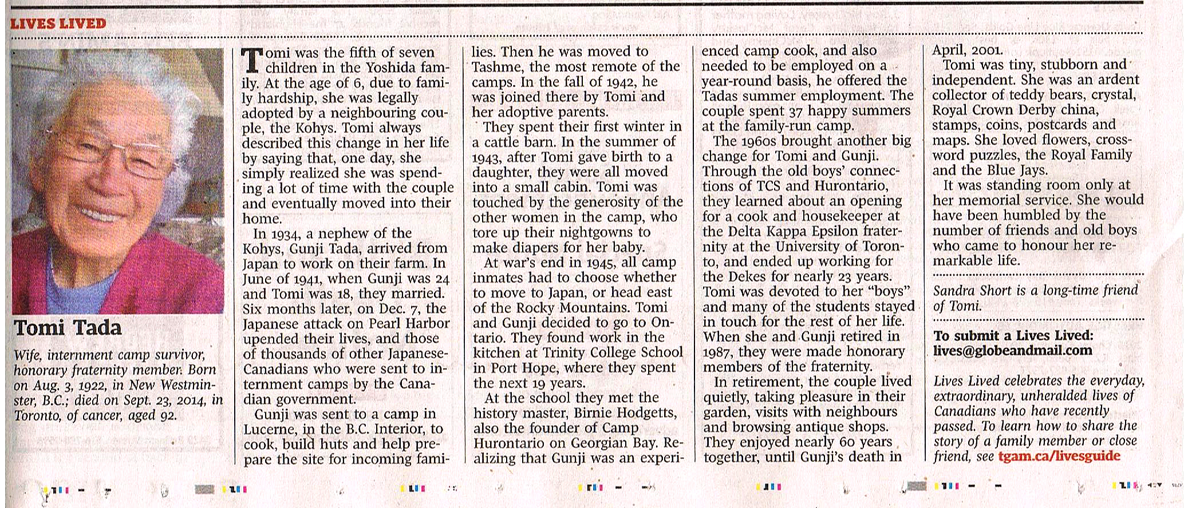

Slide 33
In September 1988, the Government of Canada formally apologized in the House of Commons and offered compensation for wrongful incarceration, seizure of property and the disenfranchisement of Japanese Canadians during WW II.
“I know that I speak for Members on all sides of the House today in offering to Japanese Canadians the formal and sincere apology of this Parliament for those past injustices against them, against their families, and against their heritage, and our solemn commitment and undertaking to Canadians of every origin that such violations will never again in this country be countenanced or repeated.”
Prime Minister Brian Mulroney’s remarks to the House of Commons, September 22, 1988

Slide 34
Adachi, Ken. The Enemy That Never Was: A History of the Japanese Canadians. Toronto: McClelland & Stewart Inc., 1991.
Oiwa, Keibo, ed. Stone Voices : Wartime Writings of Japanese Canadian Issei. Montreal: Vehicule Press, 1991.
Sleeping Tigers: The Asahi Baseball Story. NFB

Slide 35
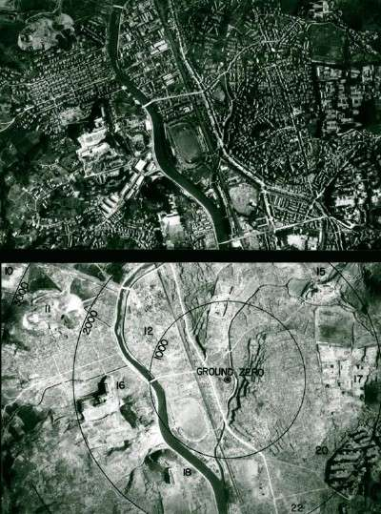

Slide 36
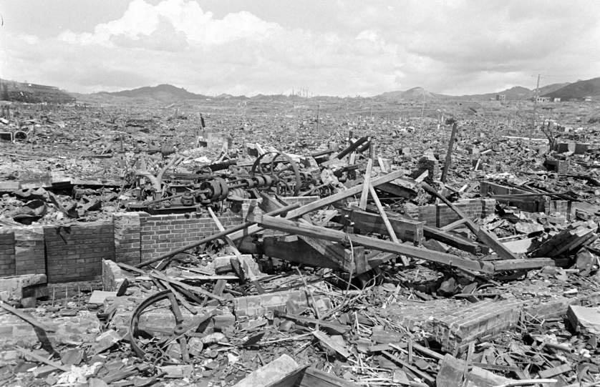

Slide 37
Re jus in bello (“justice in war”)
Let me say only this much to the moral issue involved:
Suppose Germany had developed two bombs before we had any bombs. And suppose Germany had dropped one bomb, say, on Rochester and the other on Buffalo, and then having run out of bombs she would have lost the war. Can anyone doubt that we would then have defined the dropping of atomic bombs on cities as a war crime, and that we would have sentenced the Germans who were guilty of this crime to death at Nuremberg and hanged them?
Leo Szilard, scientist, The Manhattan Project

Slide 38
It is my opinion that the use of this barbarous weapon at Hiroshima and Nagasaki was of no material assistance in our war against Japan. The Japanese were already defeated and ready to surrender because of the effective sea blockade and the successful bombing with conventional weapons.
The lethal possibilities of atomic warfare in the future are frightening. My own feeling was that in being the first to use it, we had adopted an ethical standard common to the barbarians of the Dark Ages. I was not taught to make war in that fashion, and wars cannot be won by destroying women and children.
Admiral William Leahy, American Joint Chiefs of Staff, 1945

Slide 39
Timeline:
December 2 1946;
Validity of War Measures Act appealed to the Supreme Court of Canada.
Court held act to be valid and that the deportations under the act were legal.
4,000 Canadians of Japanese origin were deported.
Full restrictions on civil rights of Canadians of Japanese origin not lifted until 1947.
1988: statement of redress by Prime Minister Mulroney.
1997: Canadian Racce Relations Foundation established in accordance to a
government commitment inn the Canadian Redress Agreement

